Slide 1

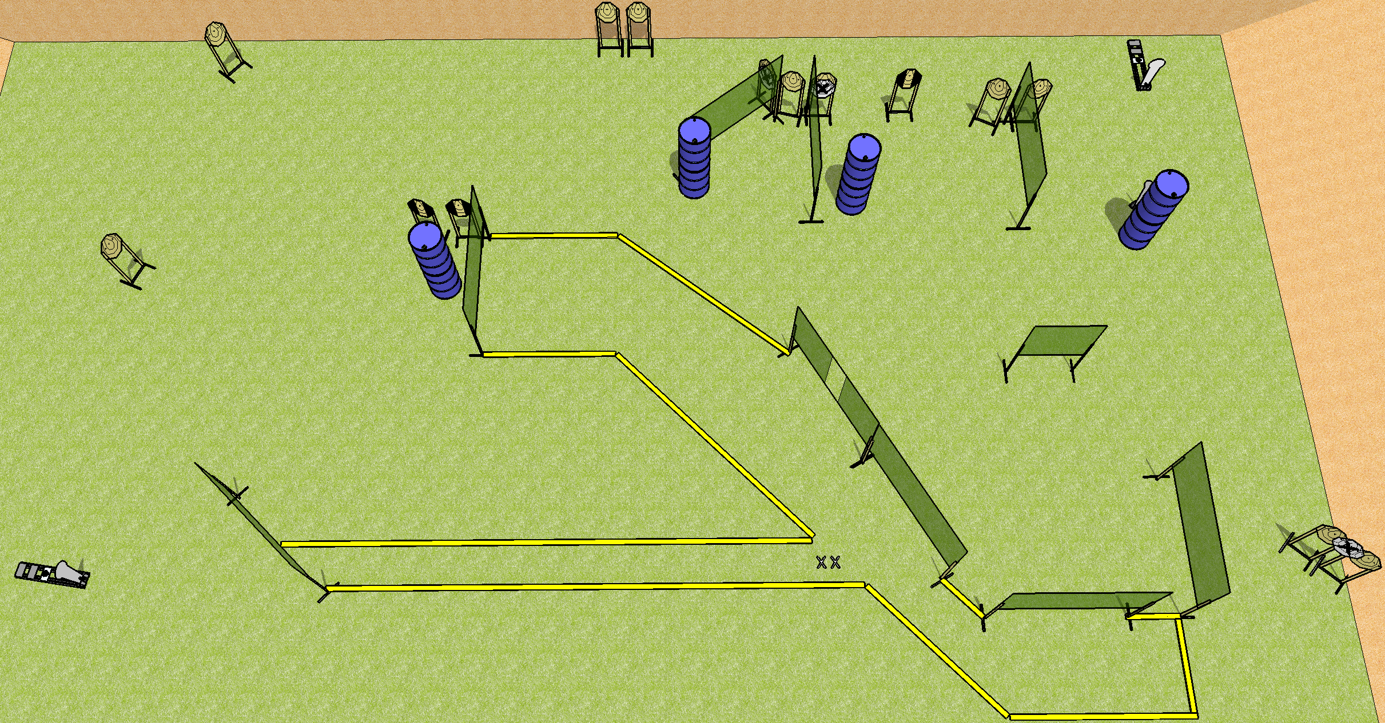
 | Dothan Practical Shooters – USPSA Match Big Bertha Course Designer : Drew Coleman Bay: A2
Round Count 31 rounds 14 IPSC 3 colt poppers
Equipment List 19 wall feet 3 tux 14 paper (11 + 3 NS)

Slide 2
Big Bertha
Written Stage Briefing
Scoring: Comstock Rounds: 31
Targets: 14 IPSC, 3 steel
Handgun start position: feet on X’s, wrists below belt. Handgun is loaded and holstered.
PCC start position: feet on X’s, stock on belt. Loaded carbine is held with both hands, safety on.
Stage Procedure: on the audible start signal, engage targets as they become available from within the shooting area.

